Slide 1

“Enhancing
Workplace
Communication
Using
Digital
Communication
Tools”
FutureTech Solution LTD

Slide 2
What Is Digital Communication?
This is the procedure of exchanging information, messages, and ideas via digital technologies and platforms. It involves the transmission and reception of data through electronic devices and networks. Digital Communication enables real-time interaction, instant messaging, video conferencing, and sharing of multimedia content across vast distances.

Slide 3
PURPOSE
Of
DIGITAL
COMMUNICATION TOOLS

Slide 4

File sharing
Collaboration
Customer engagement
Accessibility
Better engagement of workers
Comfortable and convenient experience
Universally acceptable
Transparency with the organisation
Save time, energy and money
Global Reach
Integration with other technologies
Personalisation and customisation
Data preservation and archiving

Slide 5
Social Network/ Networking
Definitions
Purposes
Social Networks are defined as websites and apps that allows user and organizations to connect, communicate, share information and form relationships.
Sharing: Allows geographically dispersed friends and families to stay connected by sharing updated, photos and videos
Learning: Users can receive real-time news, explore trending topics and keep up with community developments

Slide 6
Social Networking Con’t
Definition Con’t
Purpose Cont
Social networking refers to forming connections in person or online. Social networking sites let people connect with others across the globe whom they might never have met in person.
Eg: Facebook, X, Whatsapp, Tiktok, Facetime
Interacting: online platforms break time and distance barriers through real-time communication via text, audio or video chat
Marketing: Business use social networks to build brand awareness, retain customers and promote products or service.

Slide 7
Social Networking Con’t
Advantages
Disadvantages
Brand awareness
Global reach
Audience development
More website traffic
Misinformation
Impact of negative reviews
Data privacy and security
Burdensome time requirements

Slide 8
Use Of Tools In The Organisation Social Networking
Internal Collaboration Platforms
Employees share updates, files and announcement in real time
Teams can create dedicated channels for projects, departments or topics
Professional Networking sites
Used for recruitment, professional branding and connecting with industry peers
Help organisations showcase culture and achievement

Slide 9
Use Of Tools In The Organisation Social Networking
Social Media Platforms
Companies engage with customers, promote services and gather feedbacks
Internal groups foster community and employees engagement

Slide 10
How Social Networking Improve Workplace
Tool Type | Communication Benefit | Example
Internal Platforms | Real-time collaboration, reduced email overload | A project team uses Slack channels to coordinate tasks instantly
Professional Networking | Builds external connections, supports knowledge sharing | HR posts job openings on LinkedIn and connects with candidates
Social Media | Enhances transparency, strengthens brand communication | Marketing team shares updates on Instagram to engage customers

Slide 11
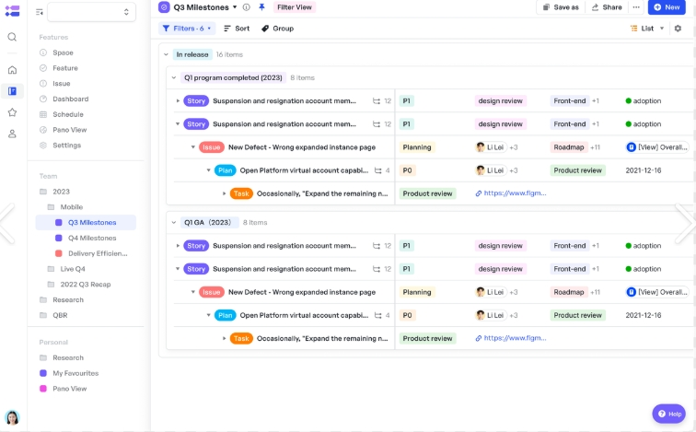
Issue Tracking Software
This is a digital tool that helps organisations records, assign, monitor and resolve problems, tasks or request in a structured ways ensuring accountability, transparency, and faster communication across teams.
Mostly used in IT, customer support and project management to streamline workflows and prevent issues from being overlooked.

Slide 12
Use Of Issue Tracking Software In the Workplace
Task Assignment and Monitoring
Centralized Record keeping
Managers assign tasks or tickets to employees with deadlines and priority levels
Such as a bug in the software system is logged in Jira assigned to a developer and tracked until resolved
All issues, updates and resolutions are stored in one system
Such as service desk or zendesk keeps a history of customer complaints and how they were resolved

Slide 13
Use Of Issue Tracking Software In the Workplace Con’t
Workflow Automation
Issues move through stages : Open - In Progress- Resolved- Closed
For Example: Trello or Asana uses boards and cards to visualise progress

Slide 14
Improves Tracking Software Improves Workplace Communication
Feature | Communication Benefit | Example
Transparency | Everyone sees the status of tasks/issues, reducing confusion | A team dashboard shows which bugs are pending and who is responsible
Accountability | Clear ownership of tasks improves responsibility | Each ticket is assigned to a specific employee
Collaboration | Comments, attachments, and updates keep all stakeholders informed | Developers and testers discuss fixes directly in Jira
Efficiency | Reduces repetitive emails and meetings | Updates are logged in the system instead of scattered across emails
Customer Communication | Provides structured responses and tracking for clients | Zendesk automatically updates customers when their issue status changes

Slide 15
Popular Issue Tracking Tools
Tool | Best For | Key Features
Jira Software | Agile software development teams | Custom workflows, sprint planning, bug tracking, integrations with DevOps tools
Linear | Fast-paced product teams | GitHub-style views, quick triage, automation, developer-friendly
monday.com | General project & issue tracking | Customizable boards, automation, SLA-style workflows
GitHub Issues | Software repositories | Labels, milestones, assignees, automation via GitHub Actions
ClickUp / Asana | All-in-one work management | Task tracking, dashboards, automations, customer request intake

Slide 16
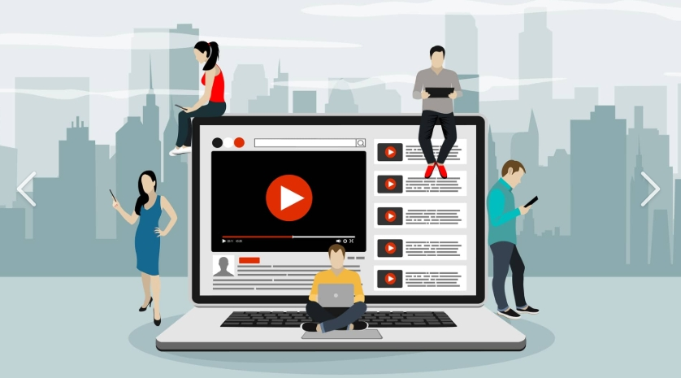
Videos
According to Template.NET a video is the art of integrating audio and visual elements into one form of multimedia, providing the audience with an image that is recorded electronically by a video camera and displayed on a television or device screen .

Slide 17
Use Of Video In The Workplace
Training and On boarding
Internal Updates
Companies create instructional videos for new employees, reducing the need for repetitive, reducing the need for repetitive in person sessions
Example: A hospital produces short videos on infection control protocols for nursing staff
Leaders share videos messages to explain organizational changes or celebrate achievements
Examples: A CEO records a video update to clarify new strategic goals

Slide 18
Use Of Video In The Workplace Con’t
Knowledge Sharing
Customer Engagement
Teams record demonstrations or tutorial to explain complex processes
Example: IT staff produces a screen recording video showing how to use new software
Companies use videos to explain product or services to clients
Example: A marketing team creates products or demo videos for customers

Slide 19
How Videos Improve Workplace Communication
Feature | Communication Benefit | Example
Visual Clarity | Complex ideas are easier to understand when shown | A training video demonstrates step-by-step safety procedures
Consistency | Everyone receives the same message | Onboarding videos ensure all new hires learn the same process
Engagement | Videos capture attention better than text | A motivational video from leadership inspires staff
Accessibility | Employees can rewatch videos anytime | Staff revisit recorded tutorials when needed
Transparency | Leaders communicate directly and openly | Video updates reduce rumors and misinterpretation

Slide 20
References
Theknowledgeacademy, What is Digital Communication: Explained with Examples
Digital Communication: Definition, Examples and its Types
Template.net, Video Definition and Meaning. February 27, 2026. Video - What Is a Video? Definition, Types, Uses
LaunchNotes, Issues Tracking, June 2026
Issue Tracking: Definition, Examples, and Applications | LaunchNotes
TechTarget, What is social networking and how does it works?
ByKatie Terrell Hanna, January
What is social networking and ,2025how does it work? | Definition from TechTarget

